Slide 2
JavaScript ES6 (also known as ECMAScript 2015 or ECMAScript 6) is the newer version of JavaScript that was introduced in 2015.
ECMAScript is the standard that JavaScript programming language uses.
ECMAScript provides the specification on how JavaScript programming language should work.

Slide 3
Let keyword
Variables declared with the var keyword are function-scoped and hoisted at the top within its scope, whereas variables declared with let keyword are block-scoped ({}) and they are not hoisted.
Block scoping simply means that a new scope is created between a pair of curly brackets i.e. {}. Therefore, if you declare a variable with the let keyword inside a loop, it does not exist outside of the loop

Slide 4
<head>
<meta charset="utf-8">
<title>JavaScript ES6 let Keyword</title>
</head>
<body>
<script>
// ES6 syntax
for(let i = 0; i < 5; i++) {
document.write(i + "<br>"); // 0,1,2,3,4
}
document.write("<hr>" + i + "<hr>"); // undefined
// ES5 syntax
for(var i = 0; i < 5; i++) {
document.write(i + "<br>"); // 0,1,2,3,4
}
document.write("<hr>" + i);
</script>
</body>
</html>

Slide 5
The const Keyword
The new const keyword makes it possible to define constants. Constants are read-only, you cannot reassign new values to them. They are also block-scoped like let.
const PI = 3.14;
console.log(PI); // 3.14
PI = 10; // error
However, you can still change object properties or array elements:
<!DOCTYPE html>
<html lang="en">
<head>
<meta charset="utf-8">
<title>JavaScript ES6 Constants are Not Truly Immutable</title>
</head>
<body>
<script>
// Changing object property value
const PERSON = {name: "Peter", age: 28};
document.write(PERSON.age + "<br>"); // 28
PERSON.age = 30;
document.write(PERSON.age + "<hr>"); // 30
// Changing array element
const COLORS = ["red", "green", "blue"];
document.write(COLORS[0] + "<br>"); // red
COLORS[0] = "yellow";
document.write(COLORS[0]); // yellow
</script>
</body>
</html>

Slide 6
The for...of Loop
The new for...of loop allows us to iterate over arrays or other iterable objects very easily. Also, the code inside the loop is executed for each element of the iterable object. Here's an example:
ExampleTry this code »
// Iterating over array
let letters = ["a", "b", "c", "d", "e", "f"];
for(let letter of letters) {
console.log(letter); // a,b,c,d,e,f
}
// Iterating over string
let greet = "Hello World!";
for(let character of greet) {
console.log(character); // H,e,l,l,o, ,W,o,r,l,d,!
}
The for...of loop doesn't work with objects because they are not iterable. If you want to iterate over the properties of an object you can use the for-in loop.

Slide 7
Template literals are created using back-tick (` `) (grave accent) character instead of the usual double or single quotes.
Interpolation
Template literals provide an easy way to interpolate variables and expressions into strings.
The method is called string interpolation.
The syntax is:
${...}
const name = 'Jack';
console.log(`Hello ${name}!`); // Hello Jack!

Slide 8
// Simple multi-line string
let str = `The quick brown fox jumps over the lazy dog.`;
// String with embedded variables and expression
let a = 10;
let b = 20;
let result = `The sum of ${a} and ${b} is ${a+b}.`;
console.log(result); // The sum of 10 and 20 is 30.

Slide 9
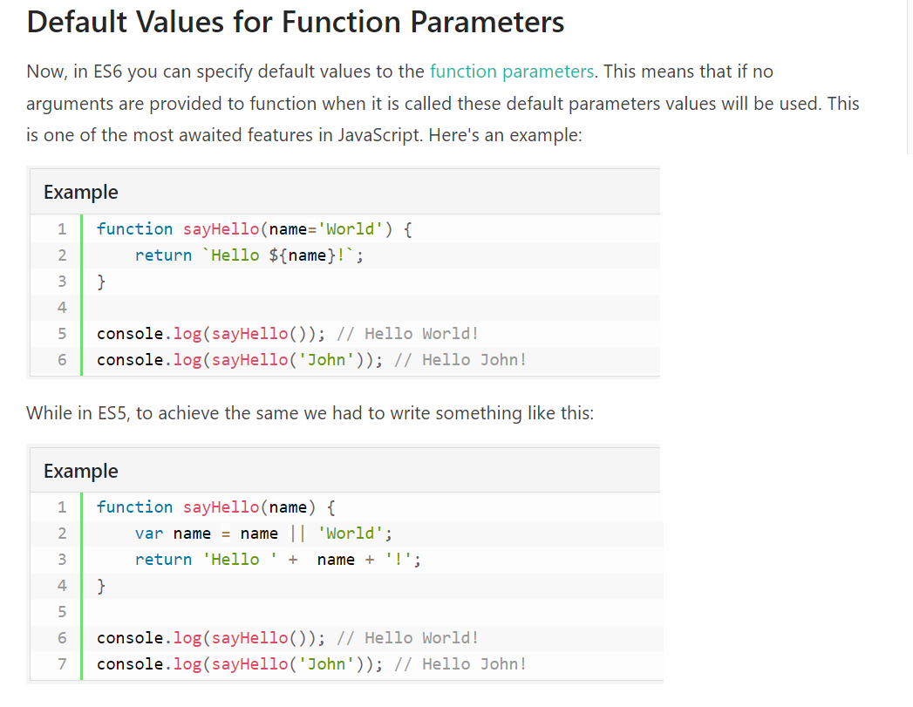

Slide 10
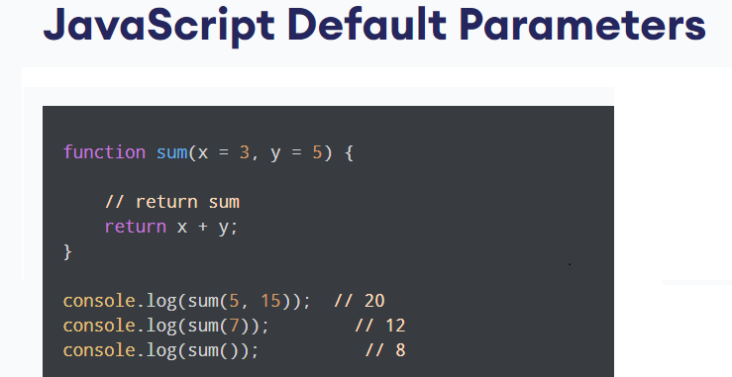

Slide 11
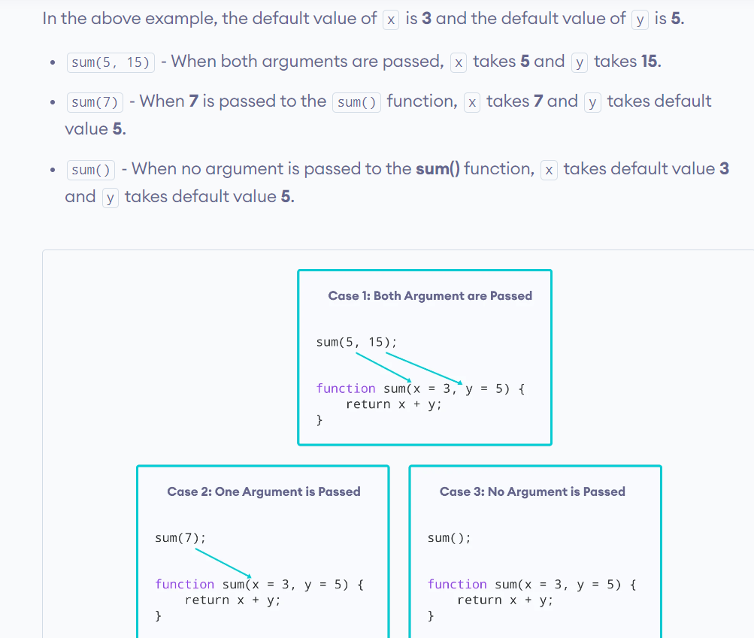

Slide 12
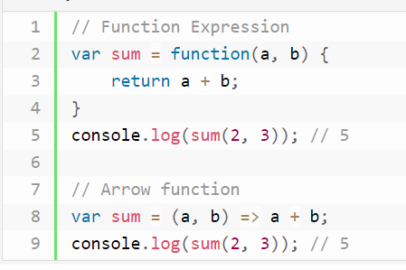
JavaScript Arrow Function
It provides a more concise syntax for writing function expressions by opting out the function and return keywords.
Arrow functions are defined using a new syntax, the fat arrow (=>) notation.

Slide 13
// Single parameter, single statement
var greet = name => alert("Hi " + name + "!");
greet("Peter"); // Hi Peter!
// Multiple arguments, single statement
var multiply = (x, y) => x * y;
alert(multiply(2, 3)); // 6
// Single parameter, multiple statements
var test = age =>
{
if(age > 18)
{
alert("Adult"); } else { alert("Teenager");
}
}
test(21);
// Adult // Multiple parameters, multiple statements
var divide = (x, y) => { if(y != 0) { return x / y; } } alert(divide(10, 2)); // 5
// No parameter, single statement
var hello = () => alert('Hello World!'); hello(); // Hello World!

Slide 14
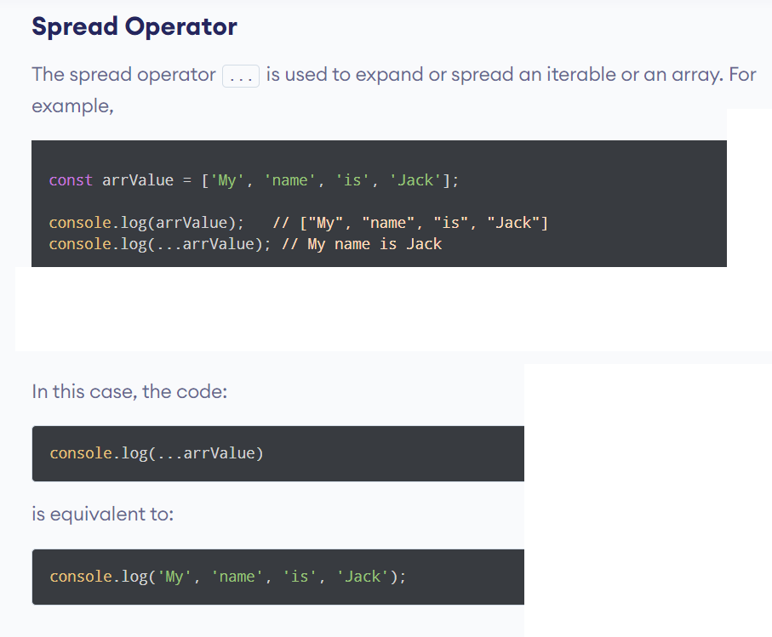

Slide 15
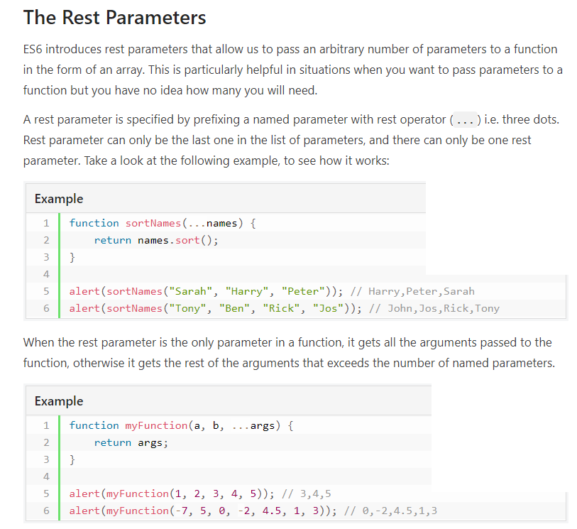

Slide 16
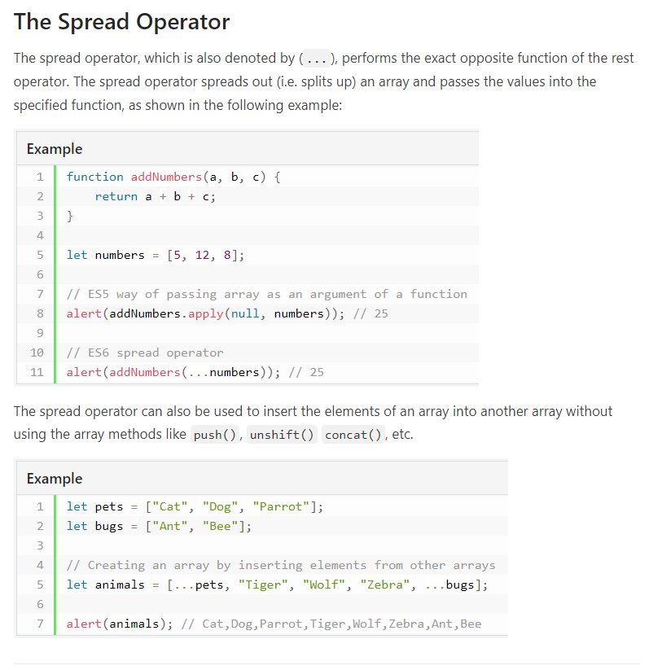

Slide 17
Destructuring Assignment
The destructuring assignment is an expression that makes it easy to extract values from arrays, or properties from objects, into distinct variables by providing a shorter syntax.
There are two kinds of destructuring assignment expressions—
the array and object destructuring assignment.
// ES5 syntax
var fruits = ["Apple", "Banana"]; var a = fruits[0];
var b = fruits[1];
alert(a); // Apple alert(b); // Banana
// ES6 syntax
let fruits = ["Apple", "Banana"];
let [a, b] = fruits; // Array destructuring assignment
alert(a); // Apple
alert(b); // Banana

Slide 18
// ES6 syntax
let fruits = ["Apple", "Banana", "Mango"];
let [a, ...r] = fruits;
alert(a); // Apple
alert(r); // Banana,Mango
alert(Array.isArray(r)); // true

Slide 19
Before ES6:
// assigning object attributes to variables
const person = {
name: 'Sara',
age: 25,
gender: 'female'
}
let name = person.name;
let age = person.age;
let gender = person.gender;
console.log(name); // Sara
console.log(age); // 25
console.log(gender); // female

Slide 20
From ES6:
// assigning object attributes to variables
const person = {
name: 'Sara',
age: 25,
gender: 'female'
}
// destructuring assignment
let { name, age, gender } = person;
console.log(name); // Sara
console.log(age); // 25
console.log(gender); // female

Slide 21
JavaScript Classes
Classes are one of the features introduced in the ES6 version of JavaScript.
A class is a blueprint for the object. You can create an object from the class.
You can think of the class as a sketch (prototype) of a house.
It contains all the details about the floors, doors, windows, etc.
Based on these descriptions, you build the house. House is the object.

Slide 22
// constructor function
function Person () {
this.name = 'John',
this.age = 23
}
// create an object
const person1 = new Person();
// creating a class
class Person {
constructor(name) {
this.name = name;
}
}
// creating a class
class Person {
constructor(name) {
this.name = name;
}
}
// creating an object
const person1 = new Person('John');
const person2 = new Person('Jack');
console.log(person1.name); // John
console.log(person2.name); // Jack

Slide 23
class Person {
constructor(name) {
this.name = name;
}
// defining method
greet() {
console.log(`Hello ${this.name}`);
}
}
let person1 = new Person('John');
// accessing property
console.log(person1.name); // John
// accessing method
person1.greet(); // Hello John

Slide 24
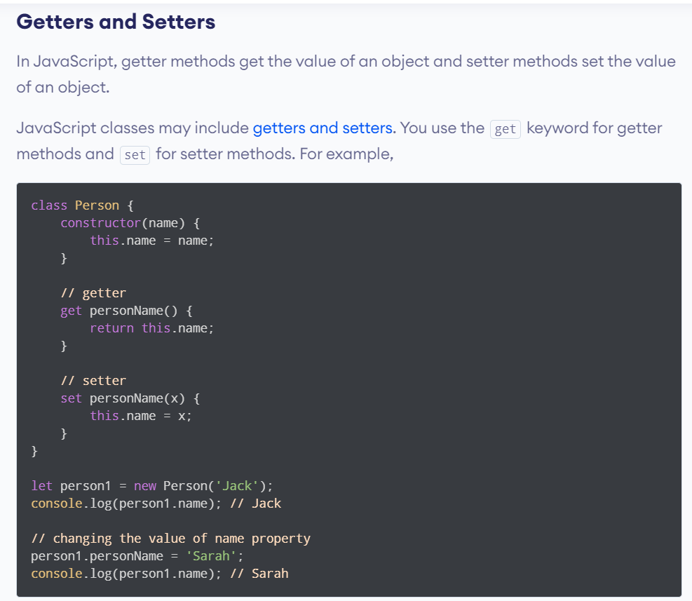

Slide 25
